Slide 1


Introduction to CGP Calculation
CGP, or Contribution Gross Profit, is a crucial metric that helps businesses understand the profitability of their products or services. It provides insights into the financial health of an organization and informs strategic decision-making.
CH. Lakshmi Nandan (192211841)
Y. Rajeshwara Reddy (192210277)

Slide 2


What is CGP?
1
Definition
CGP is the difference between a product's or service's revenue and its variable costs.
2
Importance
CGP helps businesses identify their most profitable offerings and make informed pricing decisions.
3
Calculation
CGP = Revenue - Variable Costs

Slide 3
Importance of CGP in Business
Profitability Analysis
Pricing Strategies
Resource Allocation
CGP provides a clear picture of a product's or service's profitability, allowing businesses to focus on their most lucrative offerings.
Understanding CGP helps businesses set competitive and profitable prices for their products and services.
CGP insights enable businesses to make informed decisions about resource allocation and investment priorities.

Slide 4

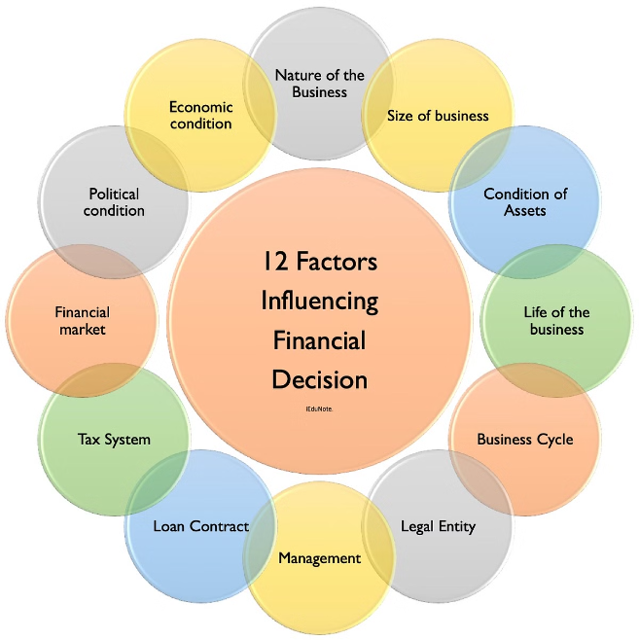
Factors Affecting CGP
Revenue
Changes in pricing, sales volumes, and product/service mix can impact revenue and, consequently, CGP.
Variable Costs
Fluctuations in material, labor, or other variable costs can affect CGP.
Market Conditions
Competitive pressures, customer demand, and economic factors can influence a company's CGP.
Operational Efficiency
Improvements in processes and supply chain management can help optimize CGP.

Slide 5





Calculating CGP
Step 1
Determine the revenue generated by a product or service.
Step 2
Identify the variable costs associated with that product or service.
Step 3
Subtract the variable costs from the revenue to calculate the CGP.

Slide 6

Interpreting CGP Results
High CGP
1
Indicates a product or service is highly profitable and should be prioritized.
2
Low CGP
Suggests the need to optimize pricing, reduce variable costs, or consider discontinuing the offering.
Trends over Time
3
Tracking CGP trends can reveal changes in a product's or service's profitability.

Slide 7






Optimizing CGP
Increase Revenue
Explore opportunities to raise prices or expand sales volumes.
Reduce Variable Costs
Optimize processes, negotiate better supplier terms, or find more efficient materials.
Adjust Product Mix
Focus on high-CGP products and phase out low-CGP offerings.
Improve Efficiency
Streamline operations to reduce waste and increase productivity.

Slide 8
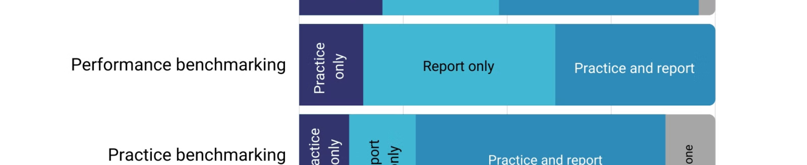
CGP Benchmarking
Industry Average CGP
Your CGP
Difference
45%
52%
+7%
Product A CGP
Product A CGP
Difference
38%
42%
+4%

Slide 9
CGP Reporting and Analysis
Regular Reporting
Trend Analysis
Comparative Analysis
Incorporate CGP reporting into your regular financial statements and management reviews.
Track CGP trends over time to identify patterns and opportunities for improvement.
Compare your CGP to industry benchmarks and competitors to gauge your performance.

Slide 10
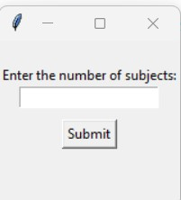
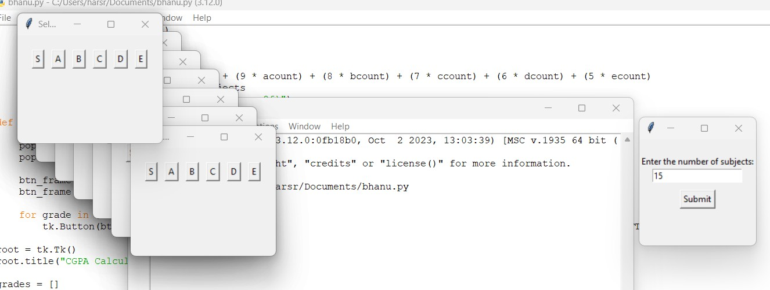
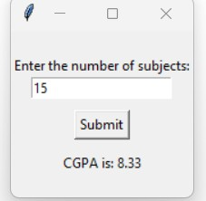
output
OUTPUT
SCREEN
:
9

Slide 11


Conclusion and Key Takeaways
1
Importance of CGP
CGP is a critical metric for understanding a business's profitability and informing strategic decisions.
2
Key Factors
Revenue, variable costs, market conditions, and operational efficiency are key factors that impact CGP.
3
Optimization Strategies
Businesses can optimize CGP by increasing revenue, reducing variable costs, adjusting product mix, and improving efficiency.
4
Continuous Monitoring
Regular CGP reporting, trend analysis, and benchmarking are essential for ongoing performance improvement.

